Slide 1
Online News Tracking
for Ad-Hoc Information Needs
Jeroen Vuurens, Arjen de Vries, Roi Blanco, Peter Mika
http://newstrackerpaper.github.io for slides and code
Notes:
In this presentation, I will talk about tracking topics in a stream of online news articles
to help the user stay updated about the news facts for a given topic,
ideally by viewing only the most relevant and novel information

Slide 2
News Tracking
Copenhagen (14-02-2015)
16:19:58 | Copenhagen - Shots were fired on Saturday near a meeting in the Danish capital of Copenhagen attended by controversial Swedish artist Lars Vilks, Sweden's TT news agency reported.
16:49:22 | COPENHAGEN, Denmark - At least one gunman opened fire Saturday on a Copenhagen cafe, killing one man in what authorities called a likely terror attack during a free speech event organized by an artist who had caricatured the Prophet Muhammad.
17:34:26 | COPENHAGEN, Denmark (AP) -- A gunman fired on a cafe in Copenhagen as it hosted a free speech event Saturday, killing one man, Danish police said.
18:51:04 | After searching for the gunman for hours, police reported another shooting near a synagogue in downtown Copenhagen after midnight.
19:29:41 | One person was shot in the head and two police were wounded in an attack on the synagogue in central Copenhagen, Danish police said, adding that it was too early to say whether the incident was connected to an earlier one at an arts cafe.
Notes:
As an introduction, we start by viewing an example from our live experiments,
in which we were tracking Copenhagen as a topic,
as you may remember on February 14th there was a shooting at an event that was to be attended by the cartoonist ~ who drew the Muhammed cartoons.
being labeled as a potential terrorist attack, this event attracted a lot of attention in the news.
As the news articles are being published,
selected sentences where extracted ~ and added to the summary on the screen.
In fact, these were the first 5 sentences that were extracted.
Every added sentence preferably captures previously unseen and important facts,
such as in this example:
shots were fired with information about the location and the event
at least one gunman, one person killed,
etc., providing the user with a concise overview ~ of the latest information related to the topic.

Slide 3
News Tracking
News events represent a unique information access problem
diverse set of news sources
news is very redundant
Notes:
The Web offers a diverse set of sources to read about news events.
For important news, these sources are often very redundant,
and as a user you often spend a significant amount of effort
re-reading the same parts of a story
before finding relevant and novel information.
News events represent a unique information access problem for which the traditional approaches to retrieve a ranked list of news articles may be ineffective.
So the task we set before us, is to assist the user by presenting an up-to-date news summary for an ad-hoc topic.

Slide 4
Related Work
Tracking news [1]:
identification of stories discussing topic
extracting salient sentences
most useful and novel sentences
[1] J. Allan, R. Gupta, and V. Khandelwal. “Temporal summaries of new topics.” In Proceedings SIGIR 2001.
Notes:
This task has received broad attention in past research,
for example as part of the Topic Detection and Tracking program,
and since 2013 in the TREC Temporal Summarization track.
The tracking of news
involves the online identification of stories that discuss a targeted topic,
and to summarize these stories.
According to Allen et al. the core technique of temporal summarization
is to extract salient or important sentences.
They provide two general criteria for the selection of sentences: The most useful and novel sentences.

Slide 5
Related Work
Dissimilarity prior sentences [1]
Similarity to many other sentences [2]
Classifier factual information [3]
[1] J. Allan, R. Gupta, and V. Khandelwal. “Temporal summaries of new topics.” In Proceedings SIGIR 2001.
[2] G. Erkan and D. R. Radev. “LexRank: Graph-based lexical centrality as salience in text summarization.” Journal of Artificial Intelligence, 2004.
[3] G.B. Tran, M. Alrifai, and E. Herder. “Timeline summarization from relevant headlines.” In Proceedings of ECIR, 2015.
Notes:
For this task, a wide range of techniques has been studied, addressing several interesting aspects. I will just name a few that were particularly inspiring for our work.
For instance, in one experiment Allen et al. address novelty by assigning a score to sentences based on differences from the prior selected sentences.
With respect to the salience of sentences, Erkan and Radev argue
that sentences that are similar to many of the other sentences
are more central to the topic.
And in recent work, Tran et al. use a classifier to distinguish factual information from opinions.

Slide 6
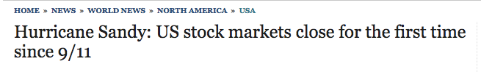
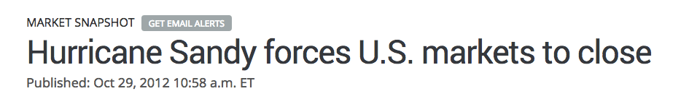
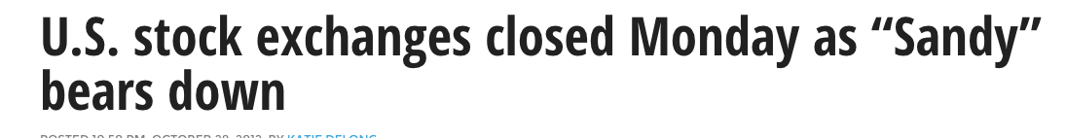
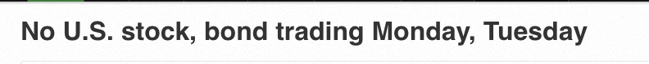
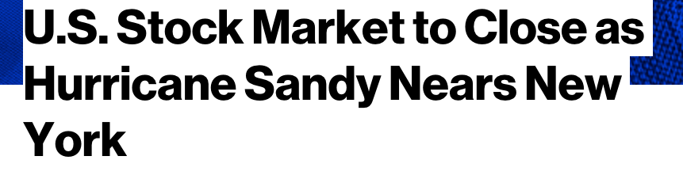
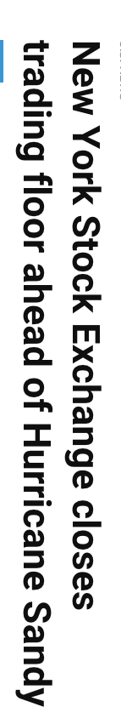
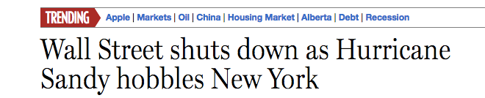
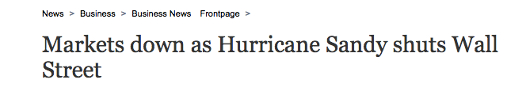
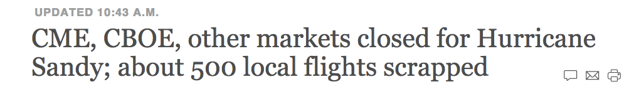
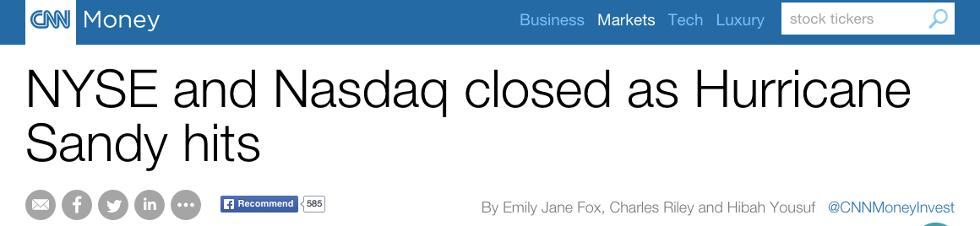
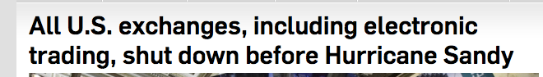
Salient sentences
Notes:
In this study, we look at news from a different perspective, and rethink what criteria indicate important news.
For example, these are some news headlines from around the time that Hurricane Sandy was closing in on New York, and the news papers announced the first unscheduled closing of Wall Street since the attack on the World Trade Center.
Two key observations that we can draw from this example,
apply to the importance of news in general:
Firstly, important news is likely to be reported by multiple news papers.
And Secondly, because importance often entails a sense of urgency, important news is often published multiple times within a short timeframe.

Slide 7
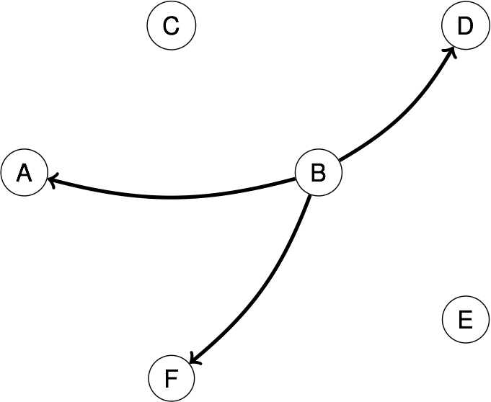
3NN Clustering
Key features salient sentences:
reported by multiple news providers
within a short timeframe
no edges between nodes same news paper
Notes:
We propose to use these two criteria in a clustering approach that aims to identify salient sentences.
In a clustering graph, every node represents a piece of information at a given publication time, in this study a node represents a sentence from a news article.
Then using some similarity score, we assign every node to its three nearest neighbors.
And, since we aim to detect similar information published by different news providers,
we do not allow edges between nodes from the same news paper.

Slide 8
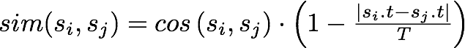
3NN Clustering
Key features salient sentences:
reported by multiple news providers
within a short timeframe
Notes:
To score similarity,
in this study, we used the cosine similarity between sentences,
multiplied by the normalized difference between their publication times,
and the latter is to promote that clusters being formed
represent information that is published within a short timeframe.

Slide 9
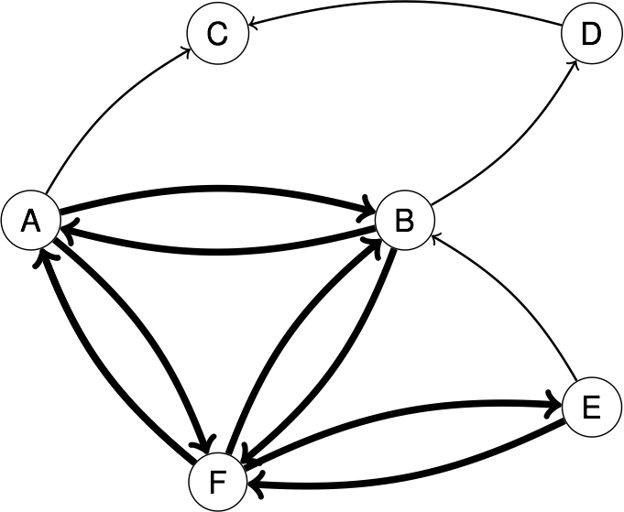
3NN Clustering
Key features salient sentences:
reported by multiple news providers
within a short timeframe
extract central information
by 2-degeneracy graph
Notes:
Then when we complete the graph by assigning every node to its three nearest neighbors,
the most central information becomes visible as the most highly connected parts of the graph.
We extract the most central information by taking the 2-degeneracy graph, which is obtained by considering only bi-directional edges, and iteratively removing nodes that have less than two connections to other nodes in the graph.

Slide 10
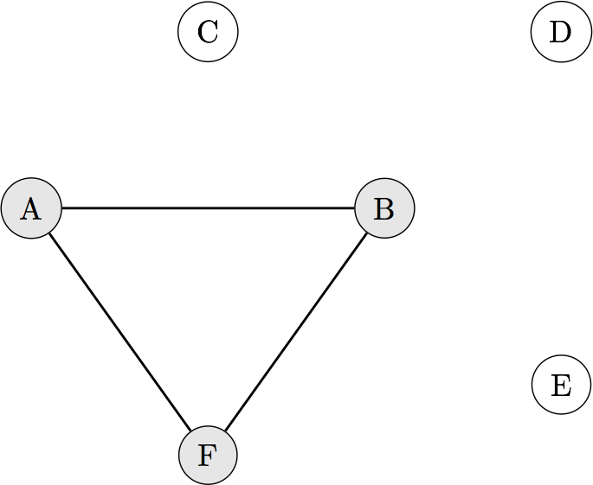
3NN Clustering
Key features salient sentences:
reported by multiple news providers
within a short timeframe
2-degenerate core
Notes:
These 2-degenerate cores represent the locally most similar information and are therefore likely to represent salient information.

Slide 11
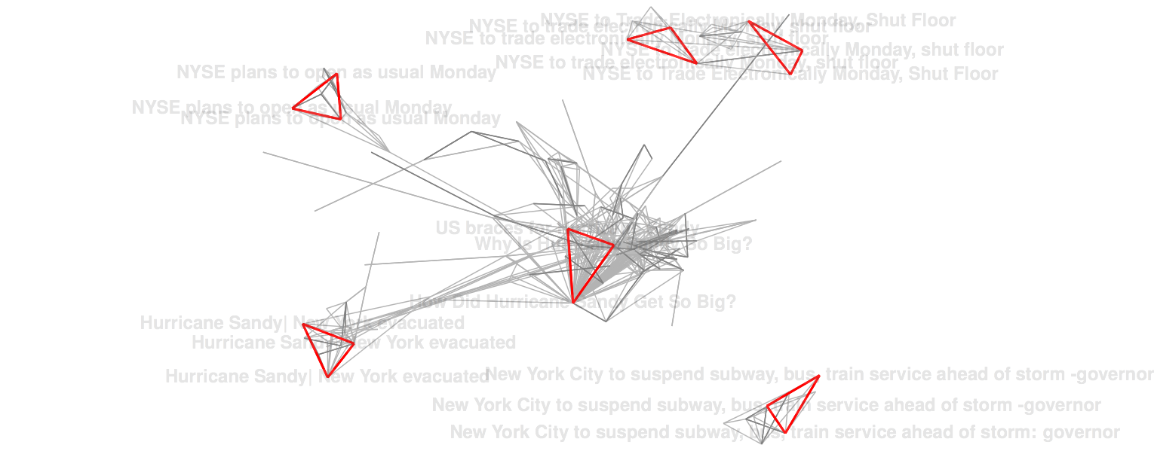
3NN Clustering
Notes:
We visualized what 3NN clustering looks like on news titles about Hurricane Sandy,
by drawing the edges between the assigned nearest neighbors.
We positioned the data so that the length of the edges drawn here reflect the similarity between the nodes,
The red triangles are the 2-degenerate cores formed.

Slide 12
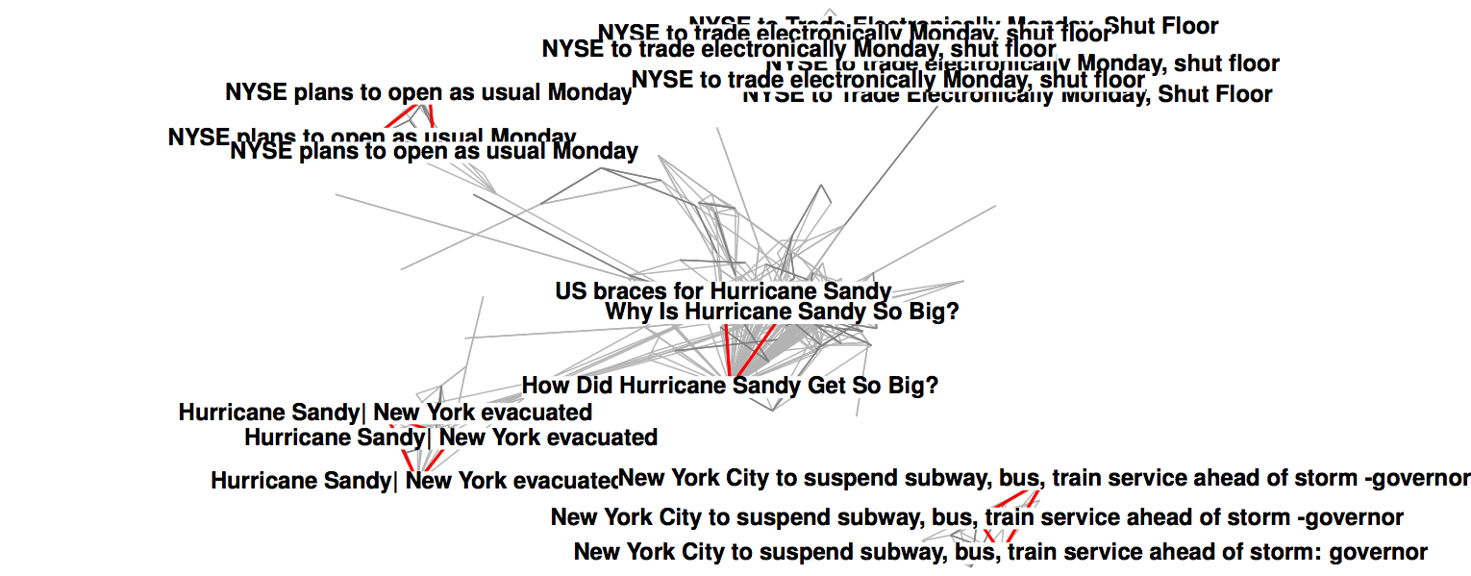
3NN Clustering
Notes:
The content associated to the core nodes reveal the information most central in this clustering graph.
For instance, at first the news was that Wall Street would open as usual on Monday,
while later the information was updated to trading would proceed only electronically.

Slide 13
3NN Clustering
wait until sufficient evidence has arrived to form a 2-degenerate core.
Notes:
As the news evolves,
it is important to distinguish between factual information and speculation.
This clustering approach reduces the likelihood of acting on information
that is speculative or information that is not important,
by waiting until sufficient evidence has arrived
to form a 2-degenerate core that supports the information.

Slide 14
3NN Clustering
mostly cores size 3
estimation importance clusters
Notes:
In 3NN clustering, the majority of 2-degenerate cores is small in size, these are mostly, like in this example, cores of 3 nodes but larger cores do occur.
If we consider only the 2-degenerate cores, this filters out a lot of information,
and we may misjudge the importance of certain facts when we don’t see how often similar information is published.
To improve the estimation of the importance of clusters,
we experimented with assigning non-core nodes
to the cluster that is assigned to their majority of nearest neighbors.

Slide 15
3NN Clustering
Assigned to cluster majority nearest neigbors:
incoherent for large clusters
Notes:
When applied, we see a large skew in cluster sizes,
the smaller clusters often contain very specific information
but in this example, the center cluster becomes highly populated and is not very coherent, this is essentially caused by the shortness of the sentences in its core.

Slide 16
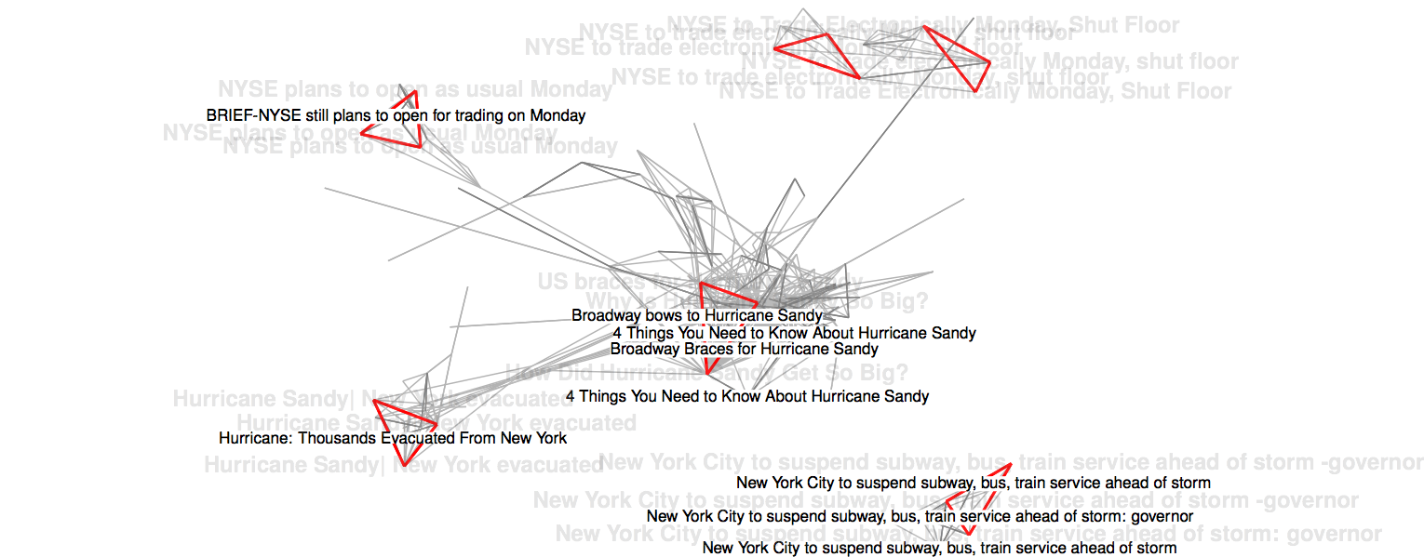
3NN Clustering
Nodes reachable from core:
likely to share additional information
Notes:
Instead, we consider a stronger criterium of relatedness to the core:
the nodes that can be reached using a directed path from one of the core nodes,
because this is a strong indication that the core sentence is very similar to the sentence that we assign to the cluster.
This example shows these nodes, and for clusters with a low population this often increases its volume with strongly related information.

Slide 17
Tracking news topics
Cluster news articles
Cluster sentences
Qualify sentences as output
Notes:
We have looked at 3NN clustering as a method to identify salient sentences in a news stream.
We will now look at the bigger picture, the task of tracking and summarizing the news for a given topic.
In this study we used a 3-step process.
Using this slide, I will first give an overview, and then discuss each step in more detail.
In step 1, we use 3NN clustering to create clusters of news articles ~ that are likely to discuss the same news.
Within the formed clusters, we identify clusters that are likely to discuss the topic we are tracking
and then use these clusters as input for step 2.
In step 2, we apply the same 3NN clustering approach, but now on the sentences that are contained in the news articles selected in step 1 for the given topic.
And in step 3, we decide whether a sentence that was identified as salient in step 2, should be added to the summary.

Slide 18
Tracking news topics
Cluster news articles
entire stream news articles
Titles only [3,5]
topic matching article clusters ⇒step 2
[3] G.B. Tran, M. Alrifai, and E. Herder. “Timeline summarization from relevant headlines.” In Proceedings of ECIR, 2015.
[5] S. L. Althaus, A. J. Edy, and P. Phalen. “Using substitutes for full-text news stories in content analysis: Which text is best?“, American Journal of Political Science 2001.
Notes:
The objective for step 1 is to cluster news articles that are likely to discuss the same news.
We perform this step over the entire stream of news articles, there is no prior filtering on the topic we are tracking.
In this study, the similarity of news articles is estimated by the cosine similarity between their titles.
Tran et al. and Althaus et al. have show that news article titles are adequate as high level summaries for the articles.
Finally in step 1, we identify clusters that are relevant to the topic we are tracking.
To this end, we monitor whether incoming news articles contain all terms for a topic in their title
— if so, these are flagged as matching the topic, and subsequently a cluster that contains such a news article is labelled as a “topic matching cluster”, and submitted for further processing in step 2.

Slide 19
Tracking news topics
Cluster sentences
Separate 3NN graph per topic
core + nodes reachable from the core
τοπιχ ματχηινγ σεντενχε χλυστερσ
⇒ step 3
Notes:
In step 2, per topic, we create a new, separate clustering graph,
to which we add all sentences from the news articles in the topic matching clusters of step 1 (as opposed to just the titles in step 1).
For this clustering step, we opted to use the same 3NN clustering approach.
Operating in a strict online setting,
if a sentence from the current news article is part of a 2-degenerate core
or is reachable by a directed path from a core node,
we push that cluster to step 3 to decide if the last sentence should be added to the summary.

Slide 20
Tracking news topics
Qualify sentences as output
Useful: similar to recently seen salient information and on-topic
[4] Y. Yang, T. Pierce, and J. Carbonell. “A study of retrospective and on-line event detection.” In Proceedings of SIGIR 1998.
Notes:
In the final step, for the qualification of sentences we use the general criteria proposed by Allen et al. that selected sentences should be useful and novel.
Our interpretation of a useful sentence is that it should be on-topic,
~ and reflect the most important and recent information seen about the topic.
Yang et al. observed that typically stories that report a new event cause a significant shift in vocabulary, and suggest using a time window for event scoping.

Slide 21
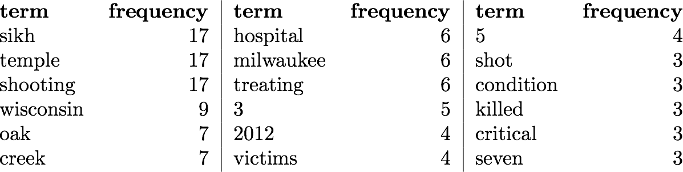
Tracking news topics
Example:
Model of recently seen salient information for topic: Sikh Temple Shooting
Notes:
Following their findings,
we estimate what information is of interest
using a model over all the words seen in the 2-degenerate cores over the past hour.
An advantage for using a model over only recently seen information, is that it allows the model to adapt when there are new developments for a topic.
This is an example of such a model
for the topic “Sikh Temple Shooting” taken from Figure 5 in the paper.

Slide 22
Tracking news topics
rank | score | sentence
1 | 0.085 | Milwaukee Hospital Treating 3 Shot at Sikh Temple MILWAUKEE August 5, 2012 ( AP ) A Milwaukee hospital is treating three victims of a shooting at a Sikh temple south of the city, all in critical condition.
2 | 0.066 | August 5, 2012 ( AP ) A police dispatcher in Wisconsin says there has been a shooting at a Sikh temple outside of Milwaukee
3 | 0.062 | US 'shooting' at Sikh temple in Oak Creek, Wisconsin
4 | 0.060 | At least seven killed in shooting at Sikh temple in Wisconsin
5 | 0.054 | Four people were shot inside the Sikh Temple of Wisconsin and three outside, including a gunman killed by police, Greenfield Police Chief Bradley Wendtlandt told reporters.
Notes:
We use that model to estimate if a new sentence covers that information better than prior selected sentences.
Using cosine similarity with this model,
we score the candidate sentences, as well as the prior selected sentences.
When in the ranking of these sentences a candidate sentence obtains a top-rank, we may add the sentence to the summary, by default we used top-5.
In this example, the novel information that was not yet covered in the prior selected sentences,
was that in this incident seven people were killed.
And a sentence in the current news article that contains that information is ranked fourth here, thus meeting the top-5 rank criterium.
So, when the information in the relevance model was already covered by sentences in the summary, it becomes less likely for candidate sentences to obtain a top rank.
But when there are new developments and the relevance model shifts to information that was not yet covered in the summary, a sentence containing that information can outranks the prior selected sentences, and may then be used.

Slide 23
Tracking news topics
Qualify sentences as output
Useful: similar to recently seen salient information and on-topic
Novel: contain previously unseen information
Notes:
In this last step,
we additionally require sentences to be on-topic and to contain novel information.
In this study, we required selected sentences to contain at least one query term,
which in our experiments showed to be a simple and effective way to avoid topic-drift.
We estimate the novelty of a sentence
by the amount of information not seen in prior selected sentences.
We experimented with two variants,
counting the number of previously unseen unigrams as a very primitive approach,
and ALTERNATIVELY counting the number of ~ previously unseen 2-word combinations in a sentence.
We compare these variants in the evaluation.

Slide 24
Evaluation
TREC 2013 Temporal Summarization
buenos aires train crash
pakistan factory fires
colorado shooting
sikh temple shooting
hurricane isaac
hurricane sandy
typhoon bopha
quatemala earthquake
tel aviv bus bombing
Notes:
We evaluated this approach using the 2013 TREC Temporal Summarisation track.
On the slide are the 9 topics contained in the test set,
and as you can see, these are all related to a type of crisis.

Slide 25
Nuggets Buenos Aires Train Crash
id | timestamp | content
1.050 | 1329945286 | train accident in Buenos Aires, Argentina.
1.051 | 1329945286 | unknown number were killed
1.052 | 1329945286 | Hundreds injured
1.053 | 1329946985 | in 2012
1.054 | 1329947346 | February 22, 2012
1.055 | 1329947346 | Dozens killed
1.056 | 1329947346 | 550 injured
1.057 | 1329948083 | about 1,000 passengers on board the train
1.058 | 1329948083 | the train crashed at the buffer stop
1.059 | 1329948083 | crashed at speed of 26 kilometers per hour
Notes:
For the evaluation, a set of information nuggets for these topics
was taken from the Wikipedia edits of the page that describes the crisis,
with the timestamp it was put on Wikipedia.
In this example for the Buenos Aires Train crash, we see that these nuggets refer to small bits of information that for the timestamp of they were put on Wikipedia are considered important up-to-date information.
Therefore initially a nugget may say an unknown number was killed, and at a later timestamp another nugget contains the updated more specific information that dozens were killed.
For participating systems, TREC annotators scored which nuggets were captured in the sentences returned.
A problem with reusing the existing test set is that for external system only a fraction of retrieved sentences has actually been annotated, as low as less than 1% in our study.
Therefore, we had to annotate the sentences returned ourselves, which we did by carefully matching returned sentences to sentences that were scored by TREC annotators and assigning the same nuggets.

Slide 26
Evaluation
Ground truth maps returned sentences to nuggets
Metrics:
Mean Expected Gain
Latency-Discounted MEG
Comprehensiveness
F-Measure
Notes:
The paper describes the evaluation metrics in more detail, but a very brief description
mean expected gain is a precision-like metric,
the latency discounted variant rewards nuggets retrieved before they were put on Wikipedia and penalizes those retrieved after the Wikipedia updates.
comprehensiveness is a recall-like metric, which also penalizes for overly verbose sentences
and the F-measure combines the mean expected gain and comprehensiveness in one metric.

Slide 27
Evaluation
System | Expected Gain | Latency DEG | Comp. | F-measure
PRIS cluster5 | 0.149 | 0.136 | 0.099 | 0.060
ICTNET run2 | 0.102 | 0.127 | 0.192 | 0.067
3NN | 0.245‡ | 0.302†‡ | 0.190 | 0.107†
† significant improvement over PRIS
‡ significant improvement over ICTNET
Notes:
We compared our approach to the two top TREC participants, PRIS obtained the highest gain of all participants and ICTNET the highest F-measure.
Both participants constructed models based on Wikipedia pages of the same event type of the topic.
The results show 60% or more improvement in F-measure, Mean Expected Gain and Latency-Discounted Expected Gain.
A benefit of our results seems to be related to a much higher gain. An inspection of the results show that we almost never return off-topic sentences, which is perhaps a results of the requirements that selected sentences contain at least one query term.
However the results do contain sentences that are redundant or are not-informative.
In terms of comprehensiveness we are about on par with ICTNET, improving recall is an interesting direction for future work.

Slide 28
Evaluation
System | Expected Gain | Latency DEG | Comp. | F-measure
PRIS cluster5 | 0.149 | 0.136 | 0.099 | 0.060
ICTNET run2 | 0.102 | 0.127 | 0.192 | 0.067
3NN | 0.245‡ | 0.302†‡ | 0.190 | 0.107†
unigram | 0.247‡ | 0.293†‡ | 0.170 | 0.101†‡
† significant improvement over PRIS
‡ significant improvement over ICTNET
Notes:
We experimented with a few variants:
For instance the estimation of the amount of novel information.
The main runs estimate this by counting the number of previously unseen two-word combinations,
which is slightly more effective than an estimation that uses unigrams.

Slide 29
Evaluation
System | Expected Gain | Latency DEG | Comp. | F-measure
PRIS cluster5 | 0.149 | 0.136 | 0.099 | 0.060
ICTNET run2 | 0.102 | 0.127 | 0.192 | 0.067
3NN | 0.245‡ | 0.302†‡ | 0.190 | 0.107†
unigram | 0.247‡ | 0.293†‡ | 0.170 | 0.101†‡
IDF weighted | 0.210‡ | 0.276†‡ | 0.166 | 0.093†
† significant improvement over PRIS
‡ significant improvement over ICTNET
Notes:
For scoring the cosine similarity between sentences and recently seen information the main run uses binary term vectors,
which is reasonable if you consider that news article sentences often contain each meaningful word only once,
and alternatively we added IDF weights, which - perhaps surprisingly - hurts effectiveness.
In 2-degenerate cores the sentences are usually highly similar.
Adding IDF weights may favor the cooccurrence of rare terms over multiple similar but less specific terms, and possibly the latter is more effective for this specific task.

Slide 30

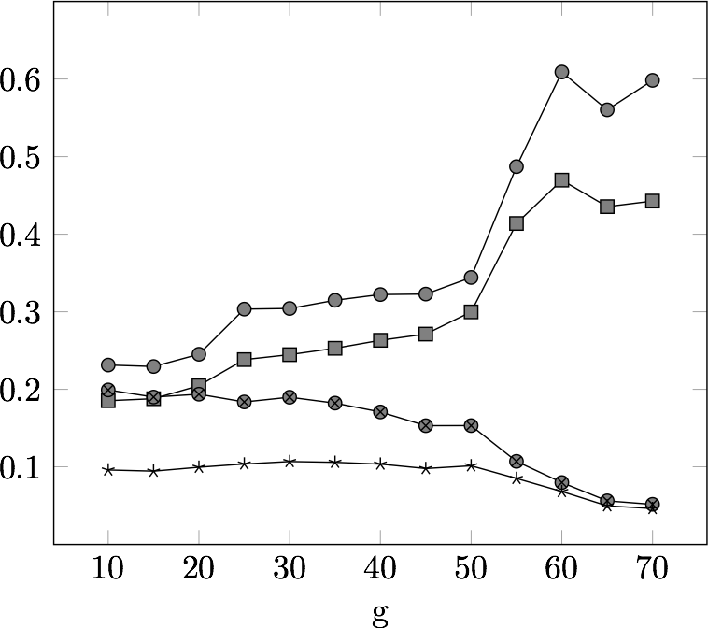
Evaluation
Minimum amount novel info
Notes:
To produce temporal summarizations for the evaluation we had to make a number of arbitrary decisions.
We analyzed the effect of changing these parameters on the effectiveness.
One of those parameters is the minimum amount of novel information a selected sentence must have.
The analysis reveals that if we require selected sentences to contain at least 70% novel information, this hurts comprehensiveness and F-measure.
We suspect that useful sentences often combine old with new information, so setting the threshold too high means that we lose comprehensiveness.

Slide 31
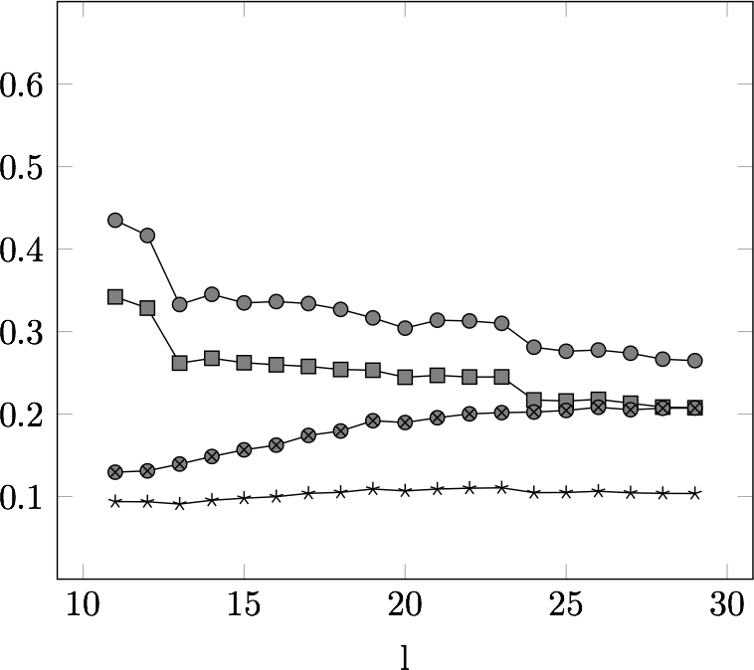
Evaluation
Maximum sentence length (#non stop words)
Notes:
We also limited the maximum sentence length to prevent using overly verbose sentences,
and despite a small trade-off between gain and comprehensiveness,
the F-measure, the lowest line in the graph, does not change much using alternative settings.

Slide 32
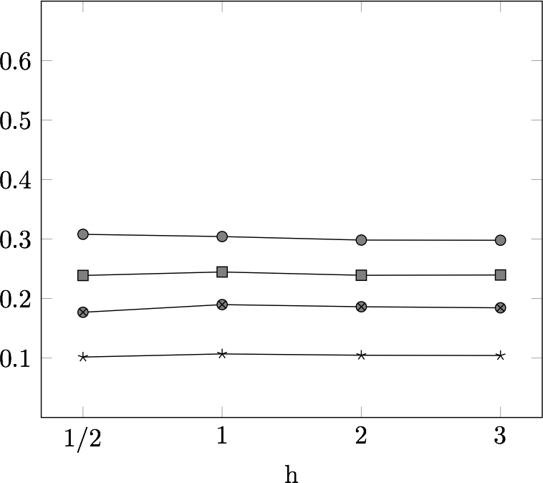
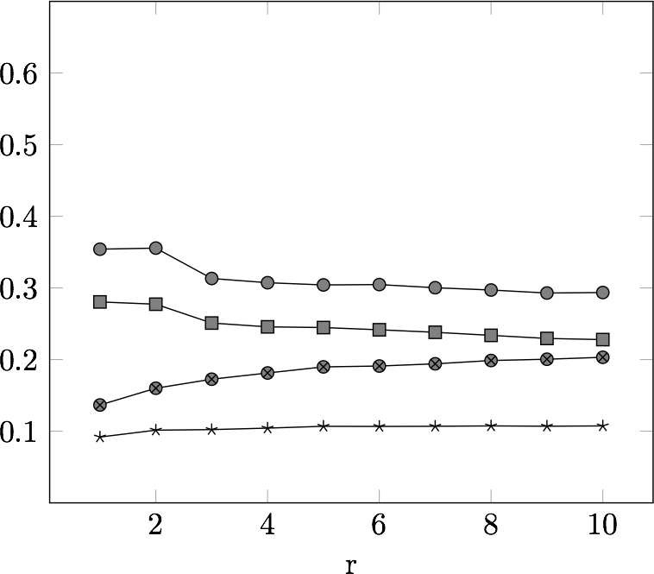
Evaluation
Minimum amount novel info
Maximum sentence length
window relevance model (hours)
rank required
Notes:
Additionally,
At the bottom left is the time period used to model recently seen information about the topic.
And at the bottom right, we control the rank that must be obtained to be selected.
Overall, in this analysis a wide range of settings produced close to similar results in F-measure, indicating that the performance was not caused by specific parameter settings.

Slide 33
Conclusion
Identify salient information using 3-NN clustering
Model of recently seen salient information
Select top-ranked sentences
Notes:
In summary:
We have proposed a novel approach to track news topics, by extracting sentences from a stream of online news articles.
Using the observation that important news is often published in multiple news papers within proximate time, we identify salient sentences as the 2-degenerate cores in a 3NN clustering graph.
By selecting only highly ranked sentences against recently seen information, we effectively reduce redundancy while allowing for novel information.
The results show 60% or more improvement in F-Measure and Mean expected gain over existing systems.

Slide 34
Questions?
[1] J. Allan, R. Gupta, and V. Khandelwal. Temporal summaries of new topics. In Proceedings SIGIR 2001.
[2] G. Erkan and D. R. Radev. “LexRank: Graph-based lexical centrality as salience in text summarization.” Journal of Artificial Intelligence, 2004.
[3] G.B. Tran, M. Alrifai, and E. Herder. “Timeline summarization from relevant headlines.” In Proceedings of ECIR, 2015.
[4] Y. Yang, T. Pierce, and J. Carbonell. “A study of retrospective and on-line event detection.” In Proceedings of SIGIR 1998.
[5] S. L. Althaus, A. J. Edy, and P. Phalen. “Using substitutes for full-text news stories in content analysis: Which text is best?“, American Journal of Political Science 2001.
http://newstrackerpaper.github.io for slides and code

